Slide 1
Elliptic Curve Cryptography, Random Number Generators and the NSA
Research Project
COMP90043 Cryptography and Security
Geordie Wicks - 185828

Slide 2
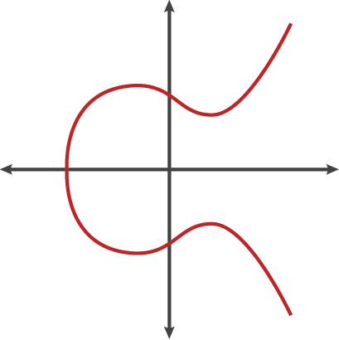
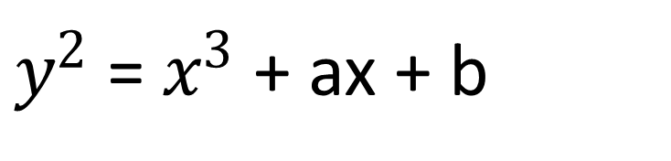
$y^{2}$= $x^{3}$ + ax + b

Slide 3
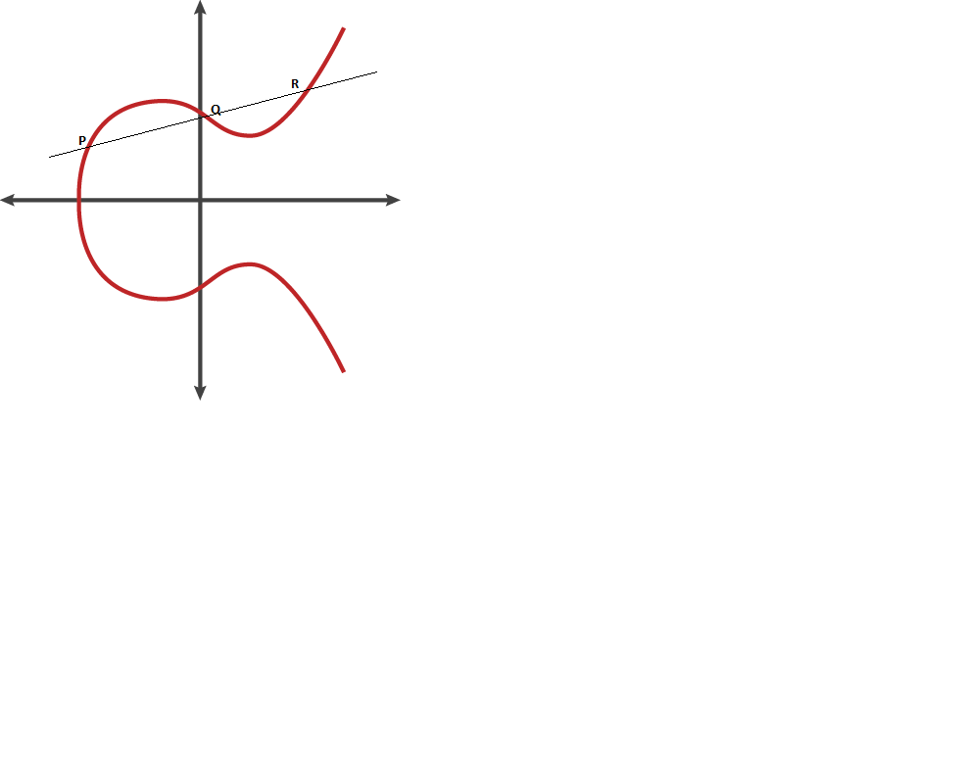

Slide 4
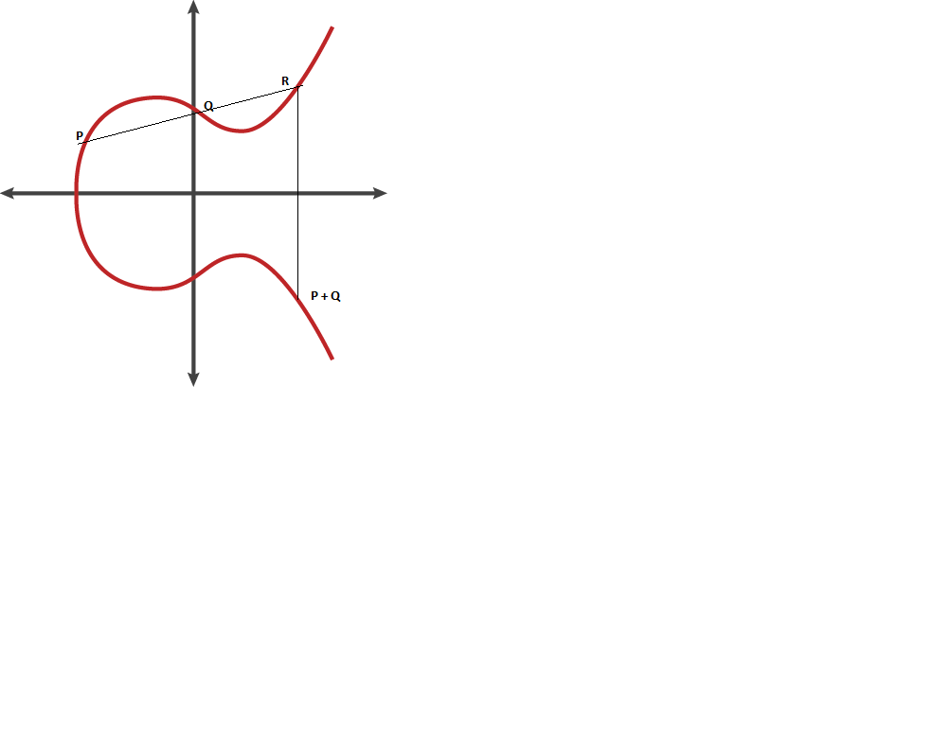

Slide 5
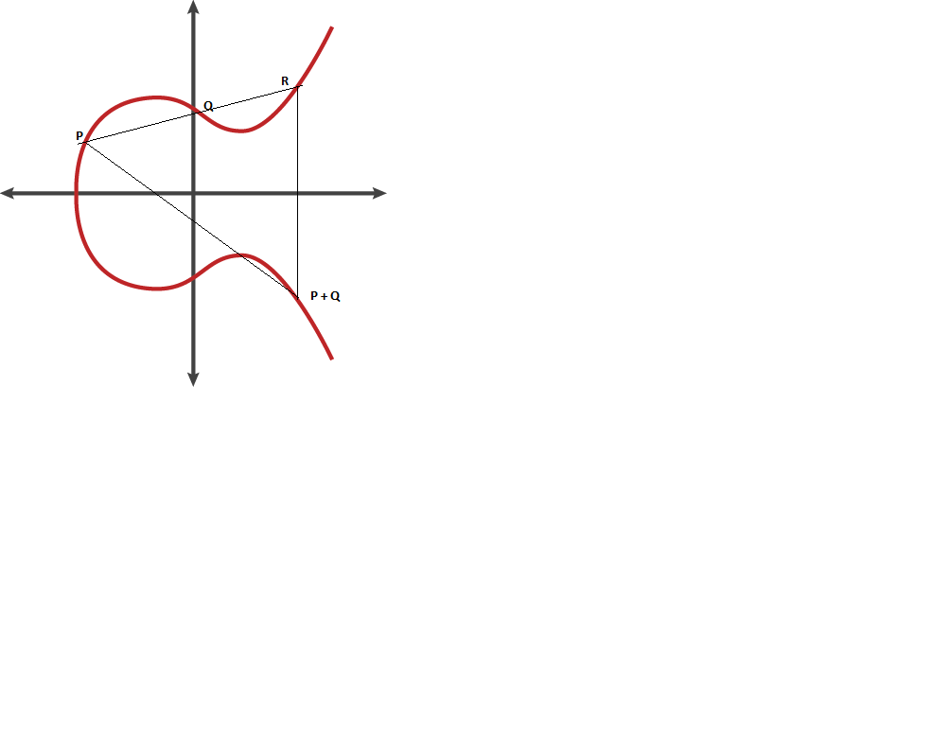

Slide 6
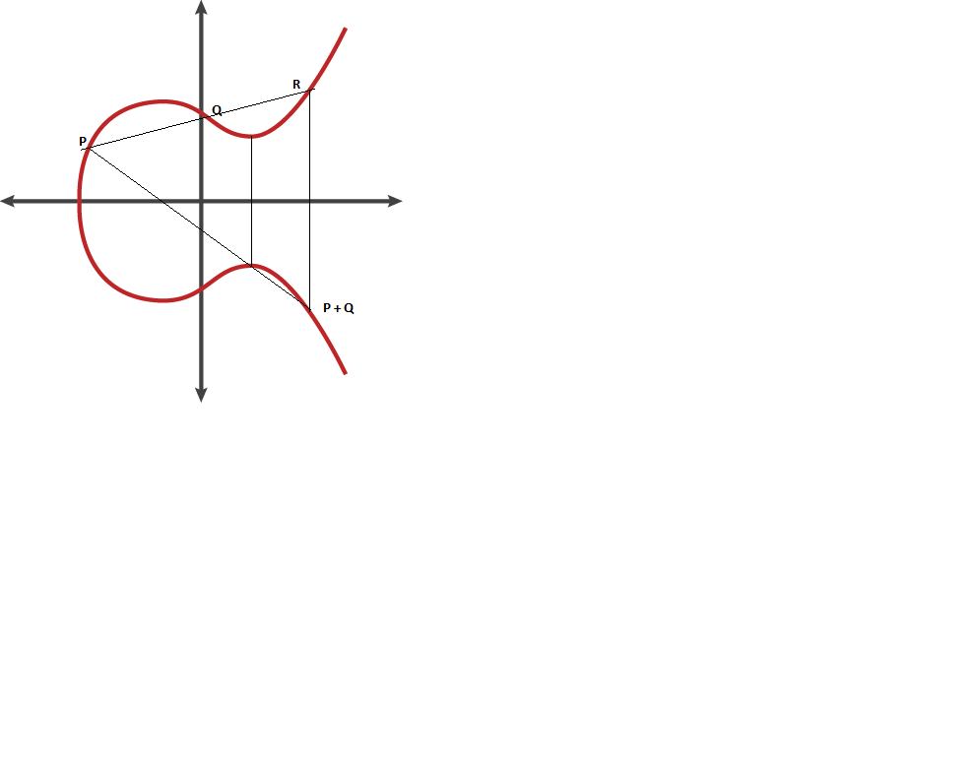

Slide 7
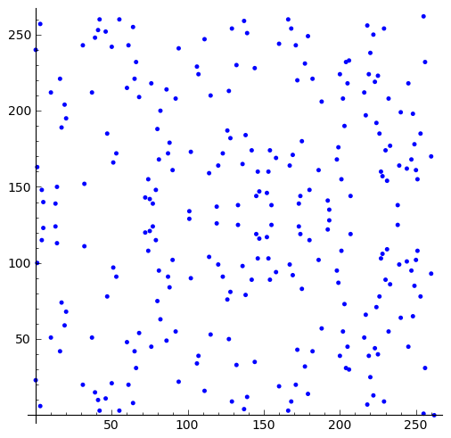

Slide 8
Dual EC_DRBG
Dual Elliptic Curve Deterministic Random Bit Generator

Slide 9
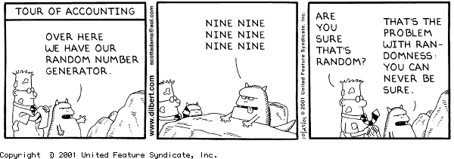

Slide 10
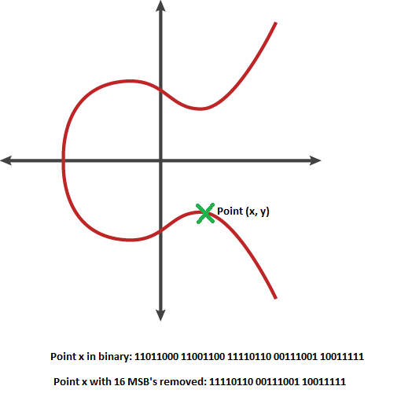

Slide 11
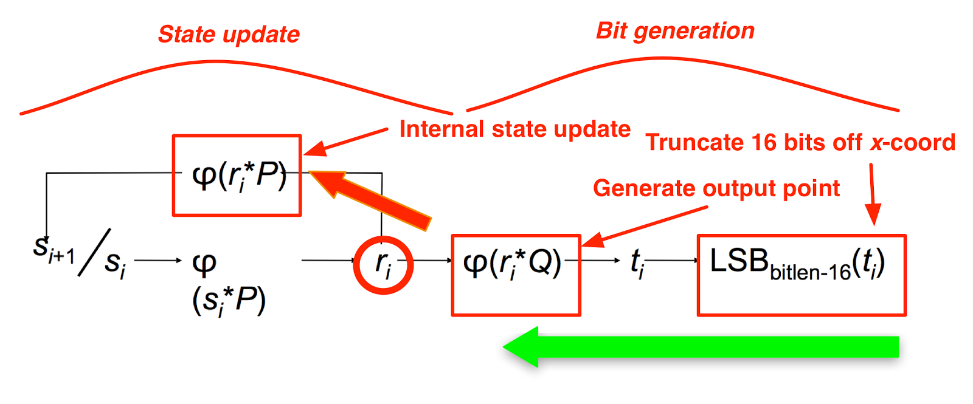

Slide 12
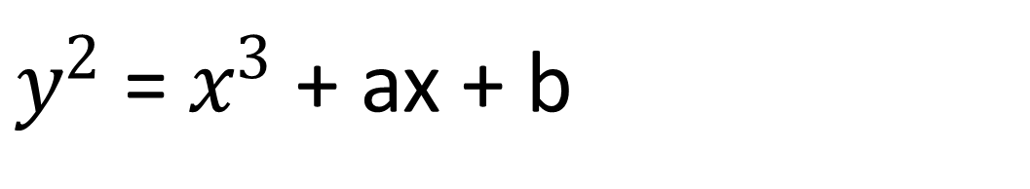
$y^{2}$= $x^{3}$ + ax + b

Slide 13
What cryptographers knew prior to 2013:
DUAL_EC_DRBG was known to have security issues prior to standards being set
Nobody from either NIST or the NSA has said where P and Q come from
NIST published a method of generating P and Q randomly in the same standards, but made the procedure to do so optional
The NSA had been pushing ECC for a while, and publically championed Dual_EC_DRBG to be included in the standard, despite knowing of its problems.

Slide 14


Slide 15
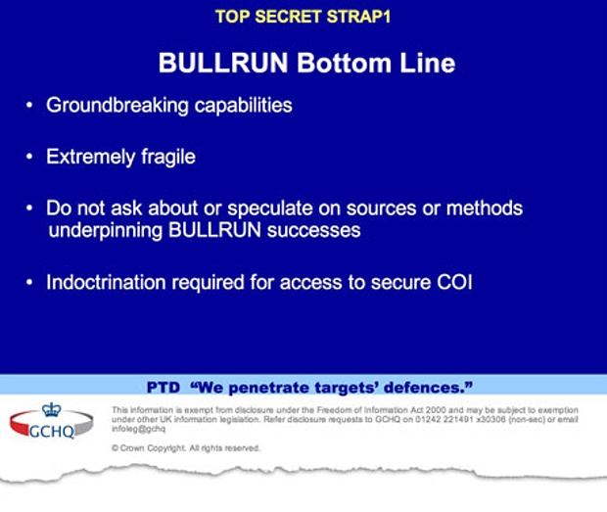

Slide 16


Slide 17


Slide 18

ECC Curve25519

